Slide 1
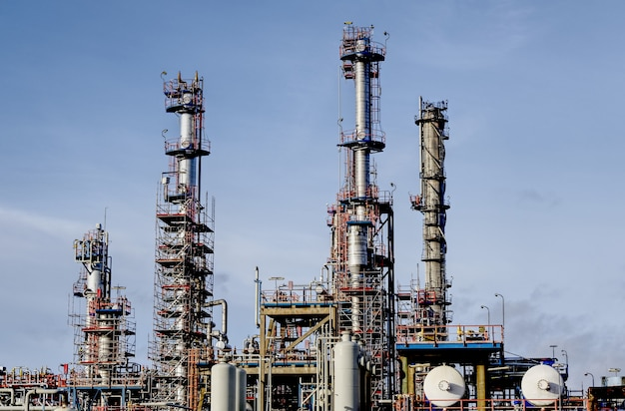
Wet Limestone FGD-Controls Module 6
Welcome Screen
Notes:
Screen Type: Interactive
Audio: Welcome to the Module 6 - Wet Limestone FGD-Controls.
Note to developer:
Show the module details and the image. Module will start when the learner clicks the Start button.
https://elements.envato.com/steaming-power-station-at-night-PNX6YDG
Global: Background image used globally: https://www.shutterstock.com/image-vector/abstract-image-nuclear-power-plant-vector-575093161

Slide 2


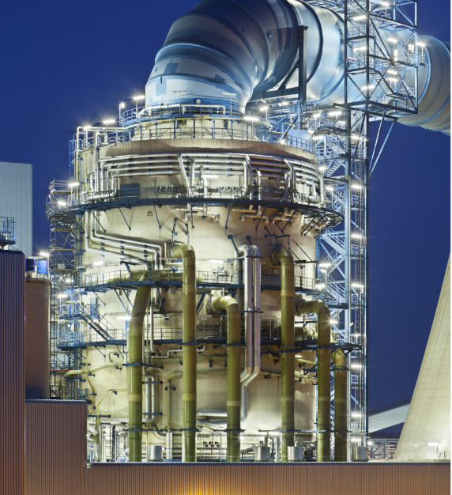
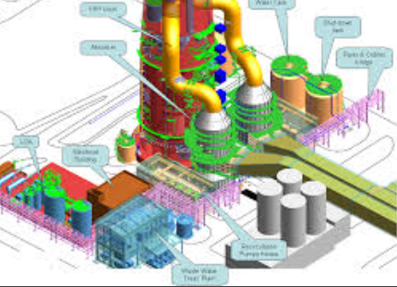
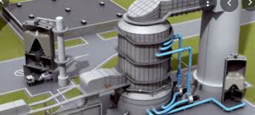
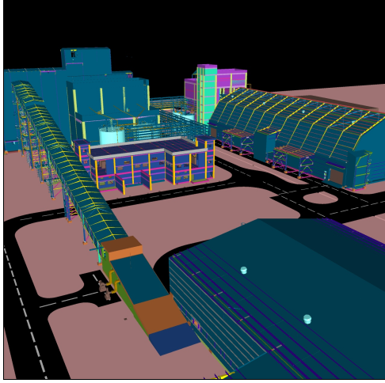

For reviewer/SME:
This slide will be a common slide, used in other modules too.
Course Overview
For reviewer/SME:
A few images have been reused from source PPT due to technicality. Please suggest image links in case these need to be replaced.
Flue-gas Desulfurization (FGD)
For reviewer/SME:
Please confirm the course name mentioned in the audio.
01
02
03
04
05
06
Basics of SO₂ &
Related Regulations
Desulfurisation Technologies
FGD Process
Major Process Equipment
Balance of Plant Equipment
FGD – Controls
Notes:
Screen Type: Animation
Audio: As you know, the Flue-gas Desulfurization or FGD course is made of six modules.
Module 1 describes the basics of Sulphur dioxide and the related regulations.
Module 2 explains the desulfurisation technologies.
Module 3 explains the process of Wet Limestone FGD.
Module 4 identifies the major process equipment's required for Wet Limestone FGD.
Module 5 explains the balance of plant equipment for Wet Limestone FGD.
Module 6 describes the controls required for Wet Limestone FGD.
Note to developer:
https://www.freepik.com/premium-vector/steps-business-timeline-process-infographic-template-design-with-icons_22886935.htm#query=six%20infographic&position=26&from_view=search&track=sph
https://www.freepik.com/free-vector/light-bulb-gears-cogs-concept_10603580.htm
https://www.freepik.com/free-vector/illustration-law-concept_2606575.htm
https://www.freepik.com/free-vector/data-center-room-with-server-hardware_10385698.htm#query=control%20room%20office&position=1&from_view=search&track=sph

Slide 3

Module Overview and Objectives
1
FGD controls
2
Typical DCS configuration
3
Major control loops - Absorber
Hi there, I’m Mr. Tech. I am here to explain all about Wet limestone FGD – Controls
to you.
4
pH / Reagent feed control
5
6
Gypsum bleed/ solid controls
pH instrumentation
For reviewer/SME:
The mascot from an earlier module has been reused here.
This slide can be removed if overview is not required. Next slide is interactive
7
8
9
Gypsum solids / density control
Density measurement
Level / make up water control
10
Booster fan control
11
Emergency quench
12
Summary
13
Assessment
Notes:
Screen type – Static
Audio:
Hi There, I’m Mr. Tech. I am here to explain all about Wet limestone FGD – Controls to you. Here is the roadmap for this module.
In topic 1, we will understand the FGD controls.
In topic 2, we will identify the Typical DCS configuration.
Proceeding ahead, in topic 3, we will recognize the Major control loops - Absorber.
The topic 4, we will know about pH / Reagent feed control.
The topic 5, we will know about pH instrumentation.
The topic 6 and 7 will cover Gypsum bleed/ solid controls and Gypsum solids / density control.
The topic 8, we will understand Level / make up water control.
The topic 9 and 10, we will learn about Level / make up water control and Booster fan control.
This will be followed by topic 11, we will recognize the Emergency quench.
The module ends with module summary and assessment.
Note to developer:
First show the mascot with speech bubble, then remove the mascot and show the module roadmap highlighting the topics in sync with the VO.
https://www.freepik.com/premium-vector/9-infographics-rectangle-paper-index-with-data-template_7196954.htm#query=nine%20infographic&position=29&from_view=search&track=sph

Slide 4




Module Outline
Topic Introduction
Typical System Configuration
Assessment
For reviewer/SME:
As designed in the planning document, this slide serves as an interactive menu screen.
FGD Controls
Major Control Loops
Click on the first icon to start the module.
Notes:
Screen Type: Interactive
Audio: Choose a topic to continue.
Note to developer: This is an interactive menu. User can select any topic from here.

Slide 5
FGD Controls
Topic Introduction
Let’s begin by understanding what FGD Controls is.
Notes:
Screen type: Static
Audio: Let’s begin by understanding what FGD Controls is.
Note to developer: On clicking the first topic, brings the user to this section.
Show the mascot, image and OST. Show the speech bubble and i-text appearing with the VO. Click Next.
Free Photo | Modern factory in an industrial zone under a blue sky (freepik.com)

Slide 6
Control System and Option Types
Augmentation of existing Main Plant Distributed Control System (DCS)
Let us start with control system and options type.
Standalone Programmable Logic Control (PLC) system
Major and Special Instruments
Continuous Emission Monitoring System (CEMS)
Select each box to know the details.
Notes:
Screen type – Click and Reveal
Audio:
<Ax1> Let us start with the type of control system and options.
<Ax2> Select each box to know the details.
Note to developer:
Show the character with the Ost in sync with the Ax1.
Show the itext with Ax2.

Slide 7

Control System and Option Types
Augmentation of existing Main Plant Distributed Control System (DCS)
Augmentation of existing Main Plant Distributed Control System (DCS)
Standalone Programmable Logic Control (PLC) system
Control and operation of main plant is carried out through Distributed control system or DCS
Extending/augmenting this DCS system is preferred for seamless FGD control, monitoring & operation from Main Plant Control room.
Major & special instruments
Continuous Emission Monitoring System (CEMS)
Select each box to know the details.
Notes:
Screen type – Click and Reveal
Audio:
Ax3> Augmentation of existing Main Plant DCS system. The main plant control and operation is carried out through Distributed control system or DCS. Extending/augmenting this DCS system is preferred for seamless FGD control, monitoring & operation from Main Plant Control room.
Note to developer:
As the learner clicks the boxes on right, show the details with audio. Once the audio ends highlight the close button.
As the audio ends show the close button highlighted.
Once the tab has been visited show a tick sign which means this tab has been visited.

Slide 8

Control System and Option Types
Augmentation of existing Main Plant Distributed Control System (DCS)
Standalone Programmable Logic Control (PLC) system
Standalone Programmable Logic Control (PLC) system
PLC control systems are widely considered for sub systems and relatively smaller requirements.
If PLC system, it shall be integrated with Exiting DCS system for remote operation and monitoring from Main Plant Control room.
Major & special instruments
Continuous Emission Monitoring System (CEMS)
Select each box to know the details.
Notes:
Screen type – Click and Reveal
Audio:
Ax4> Standalone Programmable Logic Control (PLC) system
PLC control systems are widely considered for sub systems and relatively smaller requirements.
If PLC system, it shall be integrated with Exiting DCS system for remote operation and monitoring from Main Plant Control room.
Note to developer:
As the learner clicks the boxes on right, show the details with audio. Once the audio ends highlight the close button.
As the audio ends show the close button highlighted.
Once the tab has been visited show a tick sign which means this tab has been visited.

Slide 9
Control System and Option Types
Augmentation of existing Main Plant Distributed Control System (DCS)
Major instruments & special instruments
Standalone Programmable Logic Control (PLC) system
pH analyzer, Density meter, FGD inlet SO2 & O2 analyzer, lime stone slurry flow measurement are critical process parameters.
Major & special instruments
Continuous Emission Monitoring System (CEMS)
Select each box to know the details.
Notes:
Screen type – Click and Reveal
Audio:
pH analyzer, Density meter, FGD inlet SO2 & O2 analyzer, lime stone slurry flow measurement are critical process parameters.
Note to developer:
As the learner clicks the boxes on right, show the details with audio. Once the audio ends highlight the close button.
As the audio ends show the close button highlighted.
Once the tab has been visited show a tick sign which means this tab has been visited.

Slide 10
Control System and Option Types
Augmentation of existing Main Plant Distributed Control System (DCS)
Continuous emission monitoring system (CEMS)
Standalone Programmable Logic Control (PLC) system
CEMS is very critical system and it comprises of multiple analyzers for various parameter SO₂, NO, NO₂, CO, CO₂, O₂, moisture, pressure, flow, temperature of flue gas monitoring in compliance to MoEF (Ministry of Environment, Forest and Climate Change) and pollution board requirements.
It is used for real time air emission monitoring by Pollution control boards.
Major & special instruments
Continuous Emission Monitoring System (CEMS)
Select each box to know the details.
Notes:
Screen type – Click and Reveal
Audio:
CEMS is very critical system and it comprises of multiple analyzers for various parameters such as SO2, NO, NO2, CO, CO2, O2, moisture, pressure, flow, temperature of flue gas monitoring in compliance to MoEF (Ministry of Environment, Forest and Climate Change) and pollution board requirements.
It is used for real time air emission monitoring by Pollution control boards.
Note to developer:
As the learner clicks the boxes on right, show the details with audio. Once the audio ends highlight the close button.

Slide 11




Controls, Safety and Redundancy in System
Critical equipment and process control is enhanced with triple redundant parameter monitoring for all trip events. All control measurements are Dual redundant.
Complete plant operation and control parameters (the parameters used for automatic control and operation)is ensured through redundant instrument for better reliability & safety of FGD plant.
High-tension drives (powered at 0.6 kV or higher) are equipped with a vibration monitoring system to ensure man, machine and process safety.
The complete FGD plant is designed with surveillance for both operational and non-operational areas and access control checks to regulate the plant's unauthorized entry and
unauthorized operation.
Notes:
Screen type – Video / Animation
Audio:
<Ax1> Critical equipment and process control is enhanced with triple redundant parameter monitoring for all trip events.
Complete plant operation and control parameters (the parameters used for automatic control and operation)is ensured through redundant instrument for better reliability & safety of FGD plant.
All control measurements are Dual redundant.
High-tension drives (powered at 0.6 kV or higher) are equipped with a vibration monitoring system to ensure man, machine and process safety.
The complete FGD plant is designed with surveillance for both operational and non-operational areas and access control checks to regulate the plant's unauthorized entry and unauthorized operation.
Note to developer:
Show each pointer in sync with audio.
Smart grid - Free industry icons (flaticon.com)
Engineering - Free education icons (flaticon.com)
Emission control - Free ecology and environment icons (flaticon.com)
Power plant - Free industry icons (flaticon.com)
Cctv - Free technology icons (flaticon.com)

Slide 12
Module Outline
Topic Introduction
Typical System Configuration
Assessment
For reviewer/SME:
As designed in the planning document, this slide serves as an interactive menu screen.
FGD Controls
Major Control Loops
Click on the first icon to start the module.
Notes:
Screen Type: Interactive
Audio: Choose a topic to continue.
Note to developer: This is an interactive menu. User can select any topic from here.

Slide 13

Typical System Configuration
Topic Introduction
Now, let’s move to the next to Typical System Configuration.
Notes:
Screen type: Animation
Audio: Now, let’s move to the next to Typical System Configuration.
Note to developer: On clicking the second topic, brings the user to this section.
Show the mascot, image and OST with audio.

Slide 14
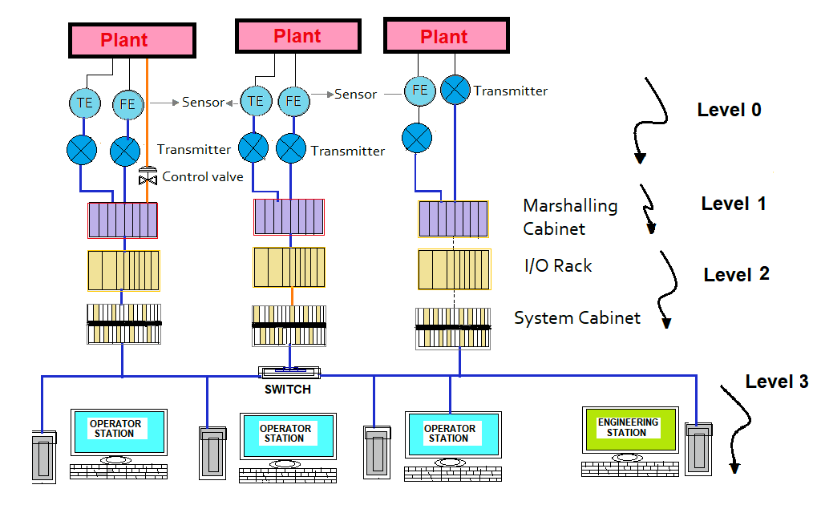
Typical System Configuration
This is the basic architecture of FGD control system.
Select the different levels to know more.
Notes:
Screen type – Video / Animation
Audio:
<Ax1> This is the basic architecture of FGD control system.
<Ax2> Let us look at each level of architecture and its significance.
<Ax3> Select the different levels to know more.
Note to developer:
Show the mascot and OST with Ax1.
Show the image with Ax2.

Slide 15

Typical System Configuration
Level 0 (Heart of the control system), comprising field instruments, transducers, sensors and transmitters. The major monitoring in the FGD plant is pH, Density, SO₂, analysers, flow, pressure, temperature, and level transmitters as major process parameters.
Select the zoom icon to know more.
Notes:
Screen type – Video / Animation
Audio:
<IAX> Select the zoom icon to know more.
<Ax1> Level 0 (Heart of the control system), comprising field instruments, transducers, sensors and transmitters. The major monitoring in the FGD plant is pH, Density, SO2, analysers, flow, pressure, temperature, and level transmitters as major process parameters.
Note to developer:
Show the image with level 0 with audio.
The zoom icon will make it easy for the learner.

Slide 16
Typical System Configuration
Level 1 or the Input/output modules - This is the part of the control system that connects the field instrument to the controller/processor of the control system. Along with these modules, marshalling or termination cabinets play a major role in the cabling of the FGD system.
Select the zoom icon to know more.
Notes:
Screen type – Video / Animation
Audio:
Level 1 or the Input/output modules – This is the part of the control system that connects the field instrument to the controller/processor of the control system. Along with these modules, marshalling or termination cabinets play a major role in the cabling of the FGD system.
Note to developer:
Show the image with level 1 with audio.
The zoom icon will make it easy for the learner.

Slide 17
Typical System Configuration
Level 2 Controller/processor of the control system is the control system's brain. Entire computing, analysis and logic are programmed into this processor/controller, which automates the entire FGD plant. Essentially, the logic in controllers is to interpret the information relayed by the transmitter/field instrument to monitor & act on the required plant/equipment/process operation.
Select the zoom icon to know more.
Notes:
Screen type – Video / Animation
Audio:
Level 2 Controller/processor of the control system is the control system's brain. Entire computing, analysis and logic are programmed into this processor/controller, which automates the entire FGD plant. Essentially, the logic in controllers is to interpret the information relayed by the transmitter/field instrument to monitor & act on the required plant/equipment/process operation.
Note to developer:
Show the image with level 2 with audio.
The zoom icon will make it easy for the learner.

Slide 18
Typical System Configuration
Level 3 This layer is also known as the user interface level, where HMI (Human machine interface) is used for the operation and monitoring of the plant by an operator.
Select the zoom icon to know more.
Notes:
Screen type – Video / Animation
Audio:
Level 3 This layer is also known as the user interface level, where HMI (Human machine interface) is used for the operation and monitoring of the plant by an operator.
Note to developer:
Show the image with level 3 with audio.
The zoom icon will make it easy for the learner.

Slide 19

Knowledge Check
Which of the following level is known as user interface level?
Select the correct option and click Submit.
Level 0
Level 1
Level 2
Level 3
SUBMIT
Notes:
Interactivity Type – MCSS
Audio: NA
Note to developer:
This is single select.
Show the OST and image.
Allow the learner to select any option(s).
Give two attempts.
Enable the SUBMIT button after an option is selected. Display the feedback and then allow the learner to click NEXT to continue.
The correct answer is indicated in Black.
Feedback:
Correct feedback:
That’s Correct! Level 3 is known as user interface level.
Incorrect feedback:
That’s Incorrect! Level 3 is known as user interface level.

Slide 20
Module Outline
Topic Introduction
Typical System Configuration
Assessment
For reviewer/SME:
As designed in the planning document, this slide serves as an interactive menu screen.
FGD Controls
Major Control Loops
Click on the first icon to start the module.
Notes:
Screen Type: Interactive
Audio: Choose a topic to continue.
Note to developer: This is an interactive menu. User can select any topic from here.

Slide 21
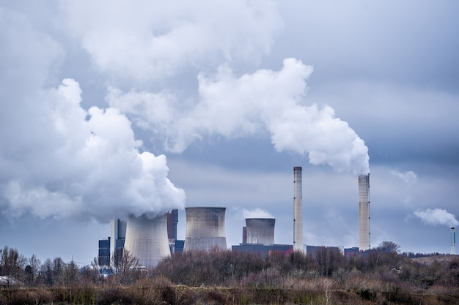
Topic Introduction
Let’s understand the Major Control Loops.
Major Control Loops
Notes:
Screen type: Interactive
Audio: Let’s understand the Major Control Loops.
Note to developer: On clicking the second topic, brings the user to this section.
Show the mascot, image and OST.
Free Photo | Wide angle shot of white smoke coming out of the nuclear plants (freepik.com)

Slide 22
Major Control Loops List
Bypass Damper control for close condition
Booster Fan control loops
Open Loop Controls
Now, let us start with the different kinds of Major Control Loops.
Booster Fan start Control
Absorber control loops
Coriolis type Density meter
Close Loop Controls
pH analyzer
Make up water
FGD Trip signals
Notes:
Screen type – List Animation
Audio:
<Ax1> Now, let us start with the different kinds of Major Control Loops.
<Ax2> The list includes:
• Bypass Damper control for close condition
• Open Loop Controls
• Absorber control loops
• Close Loop Controls
• Make up water
• FGD Trip signals
• pH analyzer
• Coriolis type Density meter
• Booster Fan start Control
• Booster Fan control loops
Note to developer:
Show the character with the Ost in sync with the audio.
Then show the list with audio 2.

Slide 23
Open and Closed Control Loops List
Open Loop Controls
Closed Loop Controls
Select each tab to know more.
Notes:
Screen type – Tabs
Audio:
<Ax1> Now, let us start with knowing the Open and Closed Loop Controls.
<Ax2> Select each tab to know more.
Note to developer:
Show the tabs with Ax1.
Show the I text with Ax2.

Slide 24
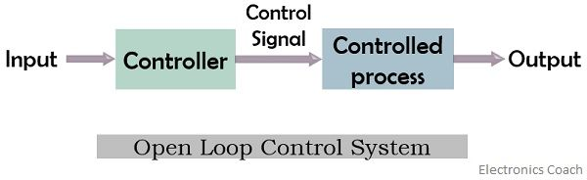
Open and Closed Control Loops List
Open Loop Controls
Closed Loop Controls
FGD Start Sequence control
FGD safe shutdown sequence controls
RC Pump sequence start stop controls
Gypsum bleed pump operation Sequence control
Notes:
Screen type – Tabs
Audio:
<Ax1> An open loop system is defined by the fact that the output signal is neither measured nor fed back for comparison with the input signal or system set point. These systems are also referred to as non-feedback systems.
<Ax2> The main open loops in the FGD plant are:
• FGD Start Sequence control
• FGD safe shutdown sequence controls
• RC Pump sequence start-stop controls
• Gypsum bleed pump operation Sequence control
Note to developer:
First Zoom in the image at centre of screen and when VO says “The major open loops in FGD plant are” show each box one by one
Clicking ‘Open Loop Controls’ in the slide ‘Major Control Loops’ bring user to this section.
Show the Right diagram with Ax2.

Slide 25
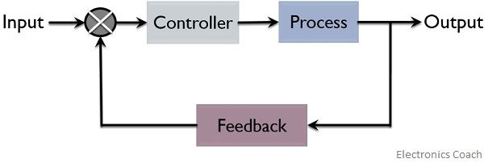
Open and Closed Control Loops List
Open Loop Controls
Closed Loop Controls
FGD Bypass Damper control
BUF blade pitch control
Absorber Level control
PH and density control in wet lime-stone
Notes:
Screen type – Tabs
Audio:
<Ax1> Closed loop systems are those which use feedback where a portion of output signal is fed back to input to reduce errors and improve stability. The term closed loop control implies use of feedback control action in order to reduce any errors within system, and its feedback which distinguishes the main differences between open loop and closed loop system.
<Ax2> The major closed control loops in FGD plant are:
FGD Bypass Damper control
BUF blade pitch control
Absorber Level control
PH and density control in wet lime-stone
Note to developer:
First Zoom in the image at centre of screen and when VO says “The major control loops in FGD plant are” show each box one by one
Clicking ‘Close Loop Controls’ in the slide ‘Major Control Loops’ bring user to this section.
Show the right diagram with Ax3.

Slide 26
FGD Trip signals
Trip = Unplanned, uncontrolled, ”emergency” shutdown of a machine or process or piece of equipment.
Example:
High vibration of a piece of rotating equipment, it’s known to “trip” that equipment.
Note to SME:
What does OEM stand for?
TPCL- Original Equipment Manufacturer
Coming to FGD Signals.
The Trip conditions are based on:
Equipment/process criticality
Process Safety
Equipment OEM recommendations
Notes:
Screen type – Animation
Audio:
<Ax0> Coming to FGD Signals.
<Ax1> Trip refers to an unplanned, uncontrolled, ”emergency” shutdown of a machine, process, or piece of equipment.
<Ax2> For example, if a high vibration is detected on a piece of rotating equipment, it’s customary to “trip” that equipment. The Trip conditions are based on equipment/process criticality, equipment OEM recommendations, and process safety.
Note to developer:
Show the mascot with Ax0.
Show the OST on right with Ax1 and Ax2.
Show the OST on left with AX3.

Slide 27
FGD Trip signals
Power Black out
Failure of all RC Pumps
Trip Conditions for the FGD plant
Bypass Damper Open
Flue Gas Inlet temperature Hi
Note to SME:
What does OEM stand for?
Both Booster fan Trip
Absorber Level Very High
Notes:
Screen type – Animation
Audio:
<Ax0> Coming to FGD Signals.
<Ax1> Trip refers to an unplanned, uncontrolled, ”emergency” shutdown of a machine, process, or piece of equipment.
<Ax2> For example, if a high vibration is detected on a piece of rotating equipment, it’s customary to “trip” that equipment. The Trip conditions are based on equipment/process criticality, equipment OEM recommendations, and process safety.
<Ax3> The trip conditions for the FGD plant are as follows:
Failure of all RC Pumps (none is in operation)
Power Blackout
Flue Gas Inlet temperature High High
Absorber Level Very High
Both Booster fan Trip
Bypass Damper Open
Note to developer:
Show the mascot with Ax0.
Show the OST on right with Ax1 and Ax2.
Show the OST on left with AX3.

Slide 28
Major Control Loops List
FGD plant starts
Sub-system is lined up
FGD scrubber tower or absorber is ready for flue gas entry
Coming to knowing about Fail Safe Condition.
Notes:
Screen type –Animation
Audio:
<Ax1> Coming to knowing about Fail Safe Condition.
<Ax2> Fail safe condition is when the FGD plant is started, the sub-system is lined up, and the FGD scrubber tower or absorber is ready for flue gas entry.
Note to developer:
Show the character with the Ost in sync with the Ax1.
Then show the smart art box with audio 2.

Slide 29
Bypass Damper control for close condition
At this stage, the flue gas is directed to the absorber through sequential operation, ensuring permissive conditions for safe operation for equipment to enable the FGD start. Fail safe Conditions include:
Note to SME:
Please validate the audio and OST.
Booster Fan Inlet / Outlet Guillotine damper open
01
02
Two RC pump in operation
03
Flue Gas Inlet temperature Normal
04
Flue Gas Inlet pressure not low and High
05
Accumulator Pressure is normal
Notes:
Screen type – Animation
Audio:
<Ax3 At this stage, the flue gas is directed to the absorber through sequential operation, ensuring permissive conditions for safe operation for each piece of equipment to enable the start of FGD.
<Ax4> Following are the Fail safe Conditions:
Booster Fan Inlet / Outlet Guillotine damper open (at least one)
Two RC pump in operation
Flue Gas Inlet temperature Normal
Flue Gas Inlet pressure not low and High
Accumulator Pressure is normal
Note to developer:
Animate the Smart art OST with the audio 1.
Animate the OST with the audio 2.
Animate the smart art on the right with audio 3.

Slide 30
Booster Fans
Booster Fan Start Control
Booster Fan Control Loops
Let us now learn about Booster Fans.
Select each tab to know more.
Notes:
Screen type – Tabs
Audio:
<Ax1> Let us now learn about Booster Fans.
<Ax2> Select each tab to know more.
Note to developer:
Show the mascot and tabs with Ax1.
Show the I text with Ax2.

Slide 31

Booster Fans
Booster Fan Start Control
Booster Fan Control Loops
Major Control Loops start the Booster Fans, both the inlet and outlet dampers should be opened and the blade pitch actuator is set to minimum position.
Any One ID Fan of respective boiler is running.
Guillotine damper at Inlet/Outlet shall be closed.
Emergency water storage tank liquid level above HIGH.
Mist eliminator wash water pump running.
Mist Eliminator water wash cycle in auto-cycle in Auto.
Bypass Damper is open and Open feedback available.
Two absorber recycle pumps are working.
Notes:
Screen type – Tab 1
Audio:
<Ax1> When starting the Booster Fans, both the inlet and outlet dampers should be opened and the blade pitch actuator is set to minimum position.
<Ax2> Keep in mind the following points:
Any One ID Fan of respective boiler is running.
Guillotine damper at Inlet/Outlet shall be closed.
Two absorber recycle pumps are working.
Emergency water storage tank liquid level above HIGH.
Mist eliminator wash water pump running.
Mist Eliminator water wash cycle in auto-cycle in Auto.
Bypass Damper is open and Open feedback available.
Note to developer:
Tab Booster Fan start Control
Show the OST at the top with AX1.
Show the smart art pointers with Ax2.
Brain - Free miscellaneous icons (flaticon.com)
Once the tab is visited show a tick sign.

Slide 32
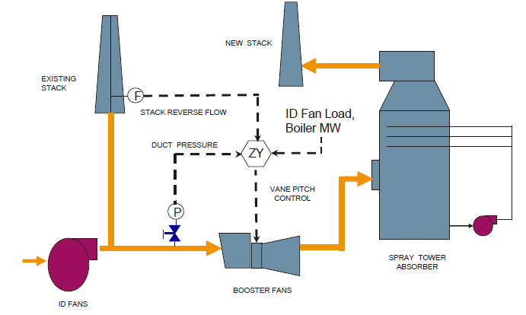
Booster Fans
Booster Fan Start Control
Booster Fan Control Loops
Axial type booster fan with variable blade pitch actuator converts the positioning signal to a mechanical movement. It can be interlocked with unit load.
Notes:
Screen type – Tab 2
Audio:
Axial type booster fan with variable blade pitch actuator converts the positioning signal to a mechanical movement. It can be interlocked with unit load.
Note to developer:
Tab: Booster Fan control loops
Show the image at centre and OST with audio.
Once the tab is visited show a tick sign.

Slide 33
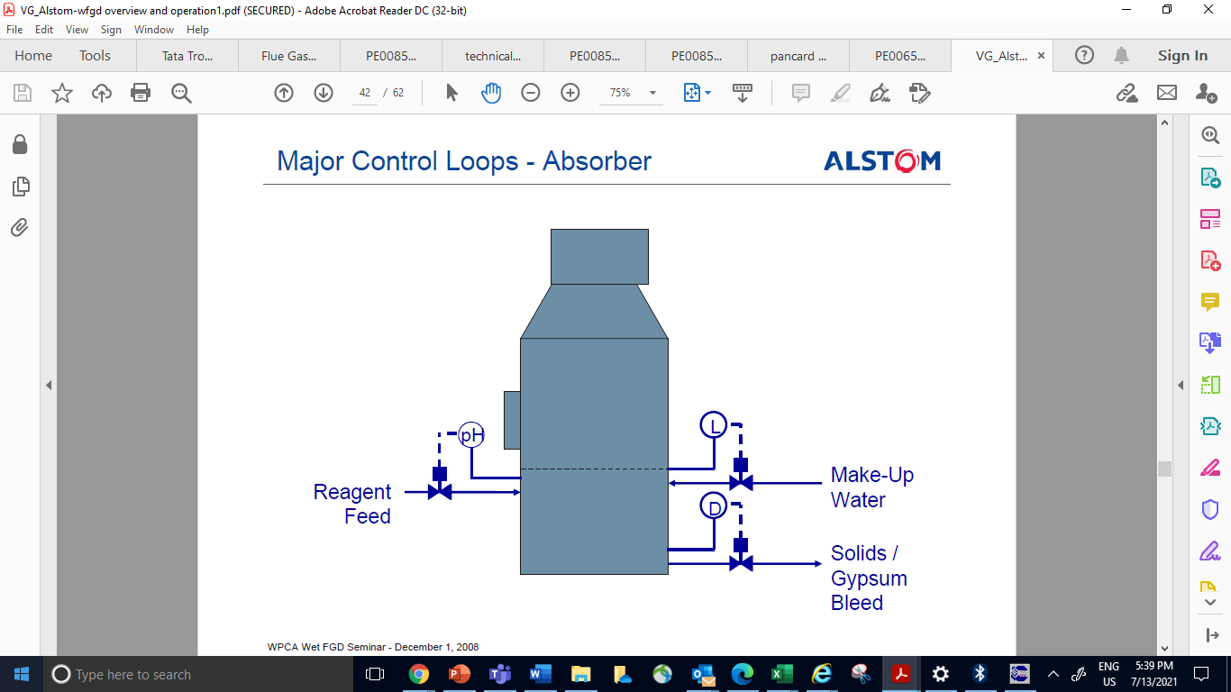
Absorber Control Loops
Coming to Absorber Control Loops, the diagram shows control loops for different inputs.
Makeup water is based on absorber level.
Limestone slurry feed is the limestone slurry added based on pH of the absorber slurry.
Make up water
Limestone slurry feed
Gypsum bleed is based on absorber slurry density.
Gypsum
bleed
Notes:
Screen type – Animation
Audio:
<Ax1> Coming to Absorber Control Loops, the diagram shows control loops for different inputs.
<Ax2> Limestone slurry feed is the limestone slurry added based on pH of the absorber slurry.
<Ax3> Gypsum bleed is based on Absorber slurry density.
<Ax4> Makeup water is based on absorber level.
Note to developer:
Show the Mascot and image with Ax1.
Then fade away the mascot.
Show the areas of OST with Ax2 to Ax4.

Slide 34
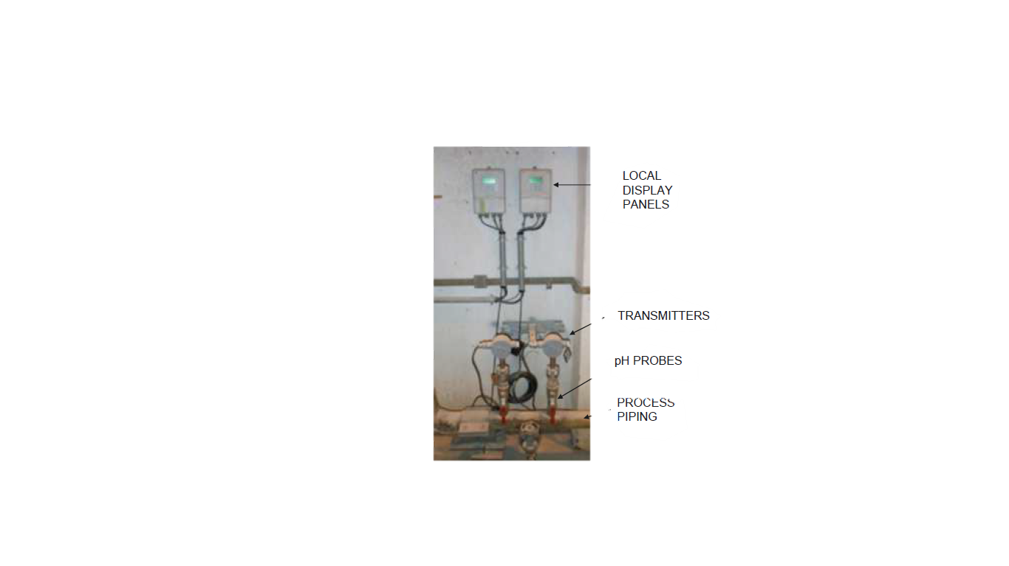
pH Analyzers
pH analyzers are used for measuring pH of absorber slurry. As well as, controls the limestone slurry addition in the absorber depending on the pH values.
Field display
Next on list are the pH Analyzers.
pH Transmitter
pH sensor
Piping
Notes:
Screen type – Animation
Audio:
<Ax1> Next on list are the pH Analyzers.
<Ax2> pH analyzers are used for measuring pH of absorber slurry. As well as, controls the limestone slurry addition in the absorber depending the pH values.
Note to developer:
Show the mascot with Ax1.
Fade the mascot. Then appear the image and OST with Ax2.

Slide 35
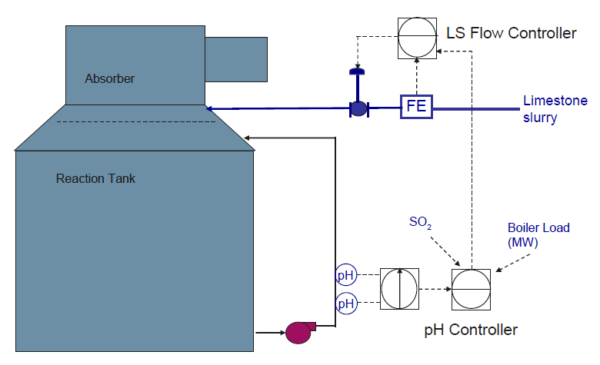
pH Control loop
pH monitoring is the next control loop to cover.
Limestone slurry makeup is added based on absorber slurry pH.
Outlet SO₂ can also be used for controlling limestone slurry addition.
A pH of 5 to 6 is maintained inside the absorber.
Notes:
Screen type – Animation
Audio:
<Ax0> pH monitoring is the next control loop to cover.
<Ax1> pH monitoring plays an important role in lime stone-based FGD and is considered representative of efficient absorber operation.
<Ax2> Limestone slurry makeup is added based on absorber slurry pH.
<Ax3> Outlet SO₂ can also be used for controlling limestone slurry addition.
<Ax4> A pH of 5 to 6 is maintained inside the absorber.
Note to developer:
Show the mascot with Ax0.
Fade the image of mascot and OST and appear the image with AX1.
Then show the pointers OST with Ax2 to Ax4.

Slide 36
Absorber Level Control
ABSORBER
MIST ELEMINATOR WASH SEQUENCE
Note to SME: No audio has been mapped for the slide.
We will be needing inputs from the SME.
TPCL- added
HIGH-HIGH
ABOVE
STOP
LIMESTONE SLURRY FEED VALVE
STOP
BELOW
FILTRATE VALVE
HIGH
ABOVE
BELOW
START
MEDIUM
ABOVE
STOP
MAKEUP WATER VALVE
BELOW
START
LOW
ABOVE
BELOW
START
LOW-LOW
ABOVE
BELOW
Notes:
Screen type – Animation
Audio: This is the summary of different actions on different levels of absorber starting from LOW-LOW level to HIGH-HIGH level. The sequence for opening or closing different feed valves i.e. process water, mist eliminator wash, filtrate, limestone slurry etc also depends on the absorber level.
Note to developer:
Show the image at centre.

Slide 37
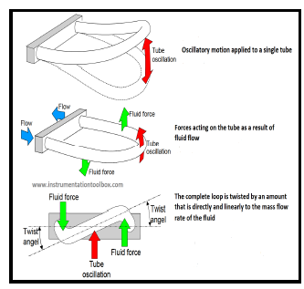
Coriolis type Density meter
Note to SME: Can we the video for showing the operation. https://youtu.be/31jYXlnu-hU
TPCL- yes from 0.06 to 2.50 mins
Works on the principles of motion mechanics
Splits when the process fluid enters the sensor
Leads the drive coil to stimulate the tubes to oscillate in opposition at the natural resonant frequency on operation. As the tubes oscillate, the voltage generated from each pickoff creates a sine wave.
The Coriolis type Density meter is next control loop.
Notes:
Screen type – Animation
Audio:
<Ax1> The Coriolis type Density meter is next control loop.
<Ax2> It works on the principles of motion mechanics. It splits when the process fluid enters the sensor. During operation, a drive coil stimulates the tubes to oscillate in opposition at the natural resonant frequency. As the tubes oscillate, the voltage generated from each pickoff creates a sine wave.
Note to developer:
Show the mascot and image with Ax1.
Show the OST with the audio Ax2.

Slide 38
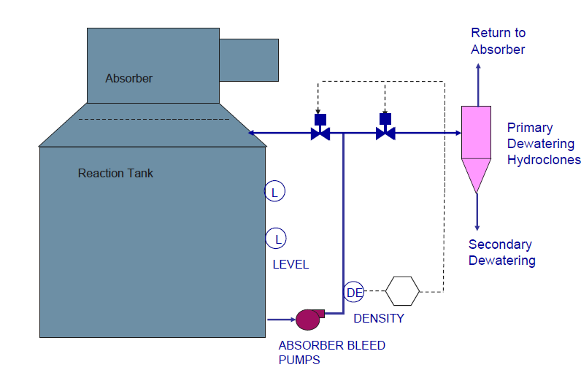
Density Control loop
The Density control is based on the slurry density at the gypsum bleed pump discharge.
Gypsum slurry will be discharged into the primary hydro cyclone feed tank or recirculated back to the absorber.
The density range is 1.2-1.3 T/m3 to discharge into the primary hydro cyclone tank.
Notes:
Screen type – Animation
Audio:
The Density control is based on the slurry density at the gypsum bleed pump discharge. Gypsum slurry will be discharged into the primary hydro cyclone feed tank or recirculated back to the absorber. The density range is 1.2-1.3 T/m3 to discharge into the primary hydro cyclone tank.
Note to developer:
Show the image and the OST with VO.

Slide 39
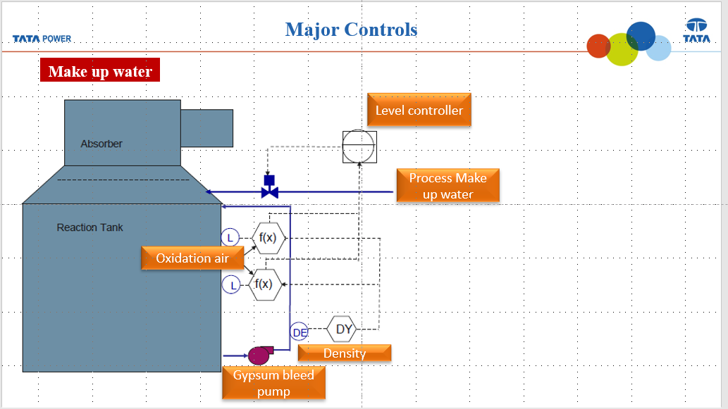
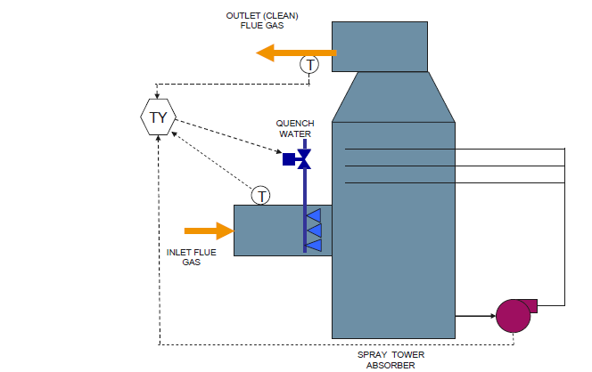
Emergency quenching water system
An emergency quench system consists of an Emergency water tank, auto valve and spray nozzles.
Quench water from the Emergency water tank is sprayed into the quenching zone of the flue gas duct before the absorber takes it by gravity.
The system is designed to supply emergency water for 15 minutes and get activated on the high temperature of inlet flue gas.
Compared with raw content slide is not used as this is not required to use
Notes:
Screen type – Animation
Audio:
An emergency quench system consists of an overhead emergency water tank, auto valve and spray nozzles. Quench water from the Emergency water tank is sprayed into the quenching zone of the flue gas duct before the absorber.. The system is designed to supply emergency water for 15 minutes and get activated on the high temperature of inlet flue gas.
Note to developer: Show the image and the OST with VO.

Slide 40
Knowledge Check
When do the major control loops start the booster fans?
Select the correct option and click Submit.
When both the inlet and outlet dampers are opened and the blade pitch actuator is set to minimum position.
When the outlet dampers is open and the blade pitch actuator is set to minimum position.
When the inlet dampers is open and the blade pitch actuator is set to maximum position.
When both the inlet and outlet dampers are opened and the blade pitch actuator is set to maximum position.
SUBMIT
Notes:
Interactivity Type – MCSS
Audio: NA
Note to developer:
This is single select.
Show the OST and image.
Allow the learner to select any option(s).
Give two attempts.
Enable the SUBMIT button after an option is selected. Display the feedback and then allow the learner to click NEXT to continue.
The correct answer is indicated in Black.
Feedback:
Correct feedback:
That’s Correct! Major Control Loops start the Booster Fans, both the inlet and outlet dampers should be opened and the blade pitch actuator is set to minimum position.
Incorrect feedback:
That’s Incorrect! Major Control Loops start the Booster Fans, both the inlet and outlet dampers should be opened and the blade pitch actuator is set to minimum position.

Slide 41
Knowledge Check
Which one of the following is based on slurry density?
Select the correct option and click Submit.
Makeup Water
Limestone Slurry
Gypsum Bleed
A and B both
SUBMIT
Notes:
Interactivity Type – MCSS
Audio: NA
Note to developer:
This is single select.
Show the OST and image.
Allow the learner to select any option(s).
Give two attempts.
Enable the SUBMIT button after an option is selected. Display the feedback and then allow the learner to click NEXT to continue.
The correct answer is indicated in Bold.
Feedback:
Correct feedback:
That’s Correct! Gypsum bleed is based on slurry density.
Incorrect feedback:
That’s Incorrect! Gypsum bleed is based on slurry density.

Slide 42
Knowledge Check
Which of the following does the Emergency quench water system gets activated on?
Select the correct option and click Submit.
High temperature of flue gas
Tripping of all RC pumps
Low temperature of flue gas
A and B both
SUBMIT
Notes:
Interactivity Type – MCSS
Audio: NA
Note to developer:
This is single select.
Show the OST and image.
Allow the learner to select any option(s).
Give two attempts.
Enable the SUBMIT button after an option is selected. Display the feedback and then allow the learner to click NEXT to continue.
The correct answer is indicated in Black.
Feedback:
Correct feedback:
That’s Correct! Emergency quench water system gets activated on high temperature of inlet flue gas and Tripping of all RC pumps.
.
Incorrect feedback:
That’s Incorrect! Emergency quench water system gets activated on high temperature of inlet flue gas and Tripping of all RC pumps.

Slide 43
Module Outline
Topic Introduction
Typical System Configuration
Assessment
For reviewer/SME:
As designed in the planning document, this slide serves as an interactive menu screen.
FGD Controls
Major Control Loops
Click on the first icon to start the module.
Notes:
Screen Type: Interactive
Audio: Choose a topic to continue.
Note to developer: This is an interactive menu. User can select any topic from here.

Slide 44

Assessment
Assessment
It is time to take the assessment now
Notes:
Screen type: Interactive – Assessment
Audio: It is time to take the assessment now.
Developer Notes: Show the on screen elements in sync with the VO.

Slide 45

Test Yourself
Assessment
You have completed the module on Wet Limestone FGD course - Controls and you are ready to take the module assessment. Please note:
You must complete all questions in one session. If you exit the assessment before all questions are answered, your answers will not be saved
You need a minimum score of 75% to pass the assessment
You can retry the assessment if you do not achieve the minimum passing score
Good Luck !
BEGIN
Notes:
Screen type: Interactive – Assessment
Audio: You have completed the module on Wet Limestone FGD course – Controls and you are ready to take the module assessment. Please note:
You must complete all questions in one session. If you exit the assessment before all questions are answered, your answers will not be saved
You need a minimum score of 75% to pass the assessment
You can retry the assessment if you do not achieve the minimum passing score
Good Luck !
Click Begin to get started with the quiz.
Developer Notes: Show the on screen elements in sync with the VO.
Clicking Begin starts the assessment.

Slide 46
Question 1 of 5
Assessment
With which of these does the Emergency quench water system get activated?
Select the correct option and click Submit.
High temperature of flue gas
Tripping of all RC pumps
Low temperature of flue gas
A and B both
Notes:
Interactivity Type – MCSS
Audio: NA
Note to developer:
This is single select.
Show the OST and image.
Allow the learner to select any option(s).
Give one attempt.
Enable the SUBMIT button after an option is selected. Display the feedback and then allow the learner to click NEXT to continue.
The correct answer is indicated in green.
Feedback:
Correct feedback:
That’s Correct! The statement is True. Hydro-cyclone is a part of a gypsum dewatering system.
Incorrect feedback:
That’s Incorrect! Hydro-cyclone is a part of a gypsum dewatering system.

Slide 47
Question 2 of 5
Assessment
Primary hydrocyclone feed is opened at which of the following density range?
Select the correct option and click Submit.
1.8-2.3 T/m3
0.2-0.3 T/m3
1.2-1.3 T/m3
1.6-2.1 T/m3
Notes:
Interactivity Type – MCSS
Audio: NA
Note to developer:
This is single select.
Show the OST and image.
Allow the learner to select any option(s).
Give two attempts.
Enable the SUBMIT button after an option is selected. Display the feedback and then allow the learner to click NEXT to continue.
The correct answer is indicated in green.
Feedback:
Correct feedback:
That’s Correct! The density range is 1.2-1.3 T/m3 to discharge into the primary hydro cyclone tank.
Incorrect feedback:
That’s Incorrect! The density range is 1.2-1.3 T/m3 to discharge into the primary hydro cyclone tank.

Slide 48
Question 3 of 5
Assessment
Which level is known as the control system's brain?
Select the correct option and click Submit.
Level 2
Level 3
Level 0
Level 1
Notes:
Interactivity Type – MCSS
Audio: NA
Note to developer:
This is single select.
Show the OST and image.
Allow the learner to select any option(s).
Give two attempts.
Enable the SUBMIT button after an option is selected. Display the feedback and then allow the learner to click NEXT to continue.
The correct answer is indicated in green.
Feedback:
Correct feedback:
That’s Correct! Level 2 is known as the control system's brain.
Incorrect feedback:
That’s Incorrect! Level 2 is known as the control system's brain.

Slide 49
Question 4 of 5
Assessment
ME wash system is activated on H-H level of absorber slurry.
Select the correct option and click Submit.
True
False
Notes:
Interactivity Type – MCSS
Audio: NA
Note to developer:
This is single select.
Show the OST and image.
Allow the learner to select any option(s).
Give one attempt.
Enable the SUBMIT button after an option is selected. Display the feedback and then allow the learner to click NEXT to continue.
The correct answer is indicated in blue
Feedback:
Correct feedback:
That’s Correct! The statement is False. ME wash system is activated on H-H level of absorber slurry.
Incorrect feedback:
That’s Incorrect! That’s Correct! The statement is False. ME wash system is activated on H-H level of absorber slurry.

Slide 50
Question 5 of 5
Assessment
pH is very crucial parameter for deciding the absorber efficiency.
Select the correct option and click Submit.
True
False
Notes:
Interactivity Type – MCSS
Audio: NA
Note to developer:
This is single select.
Show the OST and image.
Allow the learner to select any option(s).
Give one attempt.
Enable the SUBMIT button after an option is selected. Display the feedback and then allow the learner to click NEXT to continue.
The correct answer is indicated in blue
Feedback:
Correct feedback:
That’s Correct! The statement is True. pH is very crucial parameter for deciding the absorber efficiency.
Incorrect feedback:
That’s Incorrect! The statement is True. pH is very crucial parameter for deciding the absorber efficiency.

Slide 51

Result
Assessment
Congratulations!
Your score: [ ]%
You have successfully completed the module on Wet limestone based FGD – Control Process.
Click the Exit button to exit the course.
EXIT
Notes:
Screen Type: Static image
Audio: Congratulations!
You have successfully completed the module on Wet limestone based FGD Process.
Click the Exit button to exit the course.
Developer Notes: Show this screen if the scores is 75% and more. The learner can exit the course by clicking the Exit button – this displays the Thank You screen.

Slide 52

Result
Assessment
Sorry!
Your score: [ ]%
You need to score 75% or more to pass this assessment.
To retake the assessment, click Retake.
Click the Exit button to exit the course.
RETAKE
Notes:
Screen Type: Static image
VO: Sorry!
You need to score 75% or more to pass this assessment.
To retake the assessment, click Retake.
Click the Exit button to exit the course.
Developer Notes: Show this screen if the score is less than 75%. Allow learner to Retake he course by clicking Retake button. The learner can also exit the course by clicking the Exit button – this displays the Thank You screen.

Slide 53
Thankyou!
Notes:
Screen Type: Static image
VO: NA
Developer Notes: End them module with the Thank You screen.
SS ID: 692576992

